Slide 1
Market Kurly
화면 구현 설계
김민정
2021-01-18 ~

Slide 2
전체 화면 분석
https://www.kurly.com/shop/main/index.php

Slide 3
전체 화면 분석

Slide 4
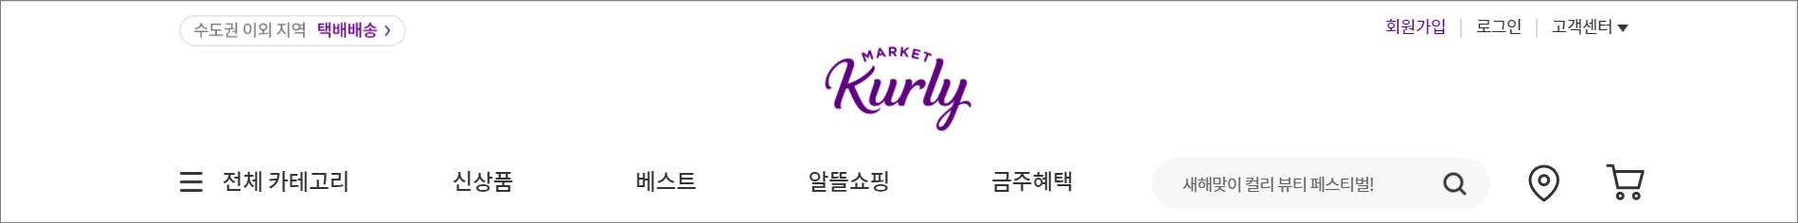
HEADER
- - -
<div.inner>
<header>
<nav.user-menu>
<img.logo>
<ul.gnb-menu>

Slide 5
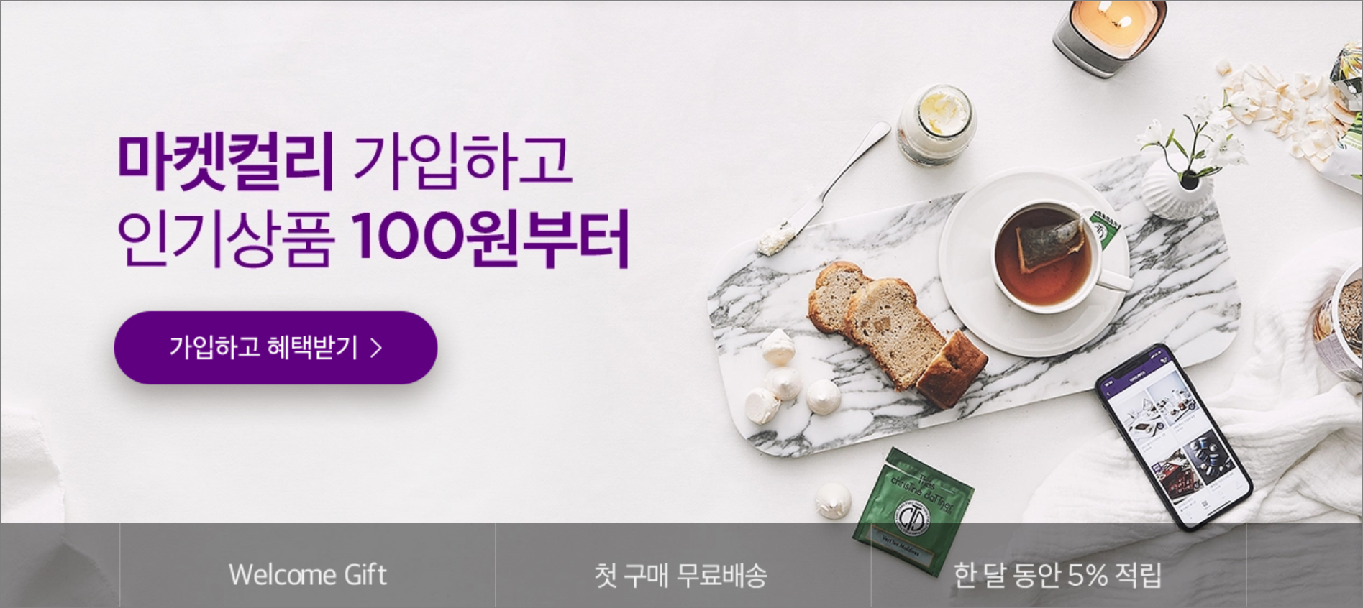
MAIN_VISUAL

Slide 6
MAIN_VISUAL
<section.main_visual>
<img.main__img>
<ul.main__btn>

Slide 7
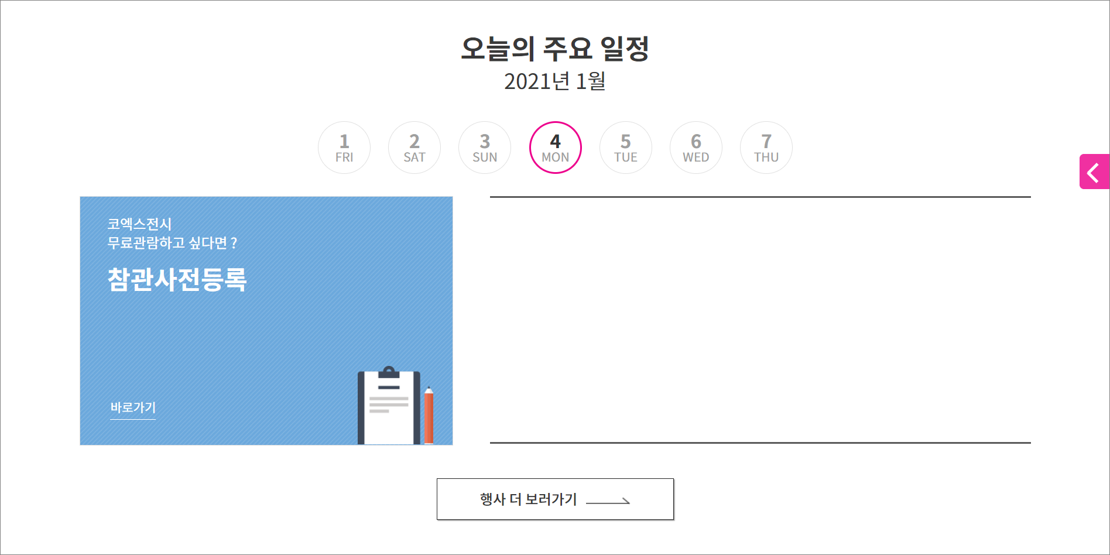
CONTENTS

Slide 8
CONTENTS
- - -
<div.inner>
<section.contents_row1>
<p. title_main>
<ui.week>
<div.eventBox>
<div. layerBox>
<a.btn>

Slide 9
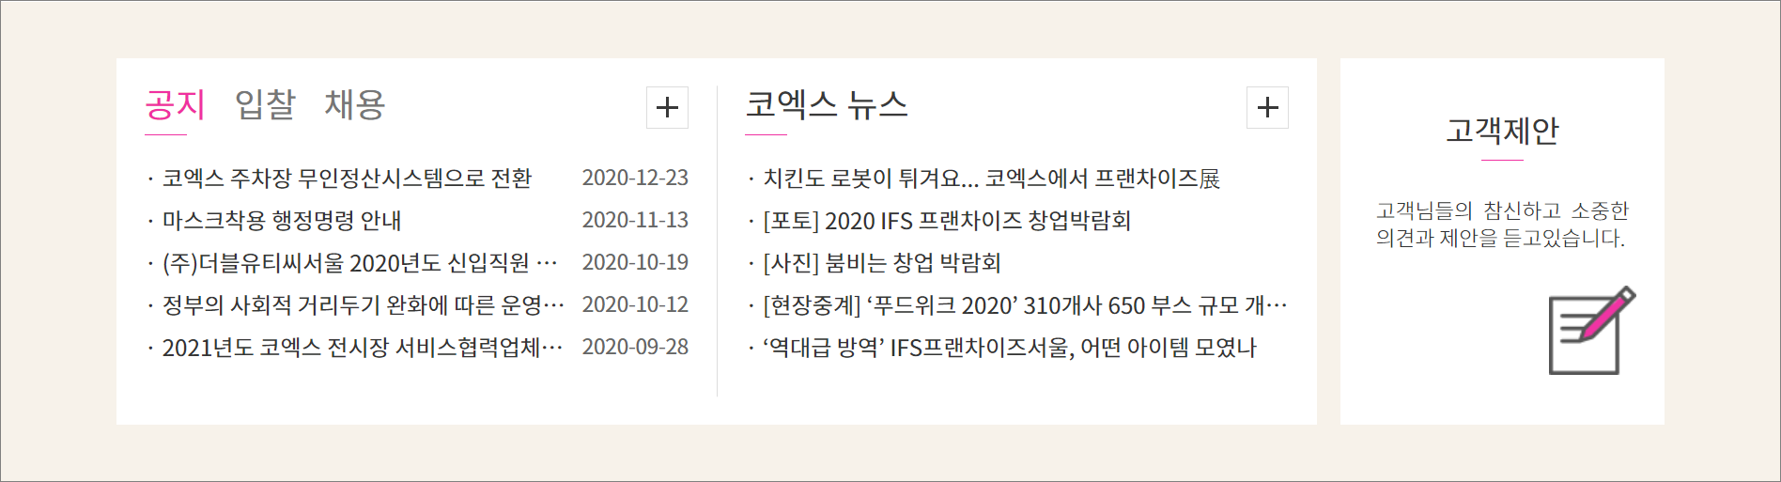
CONTENTS

Slide 10
CONTENTS
- - -
<div.inner>
<section.contents_row2>
<div.wrap_board>
<div.wrap_news>
<div.wrap_offer>

Slide 11
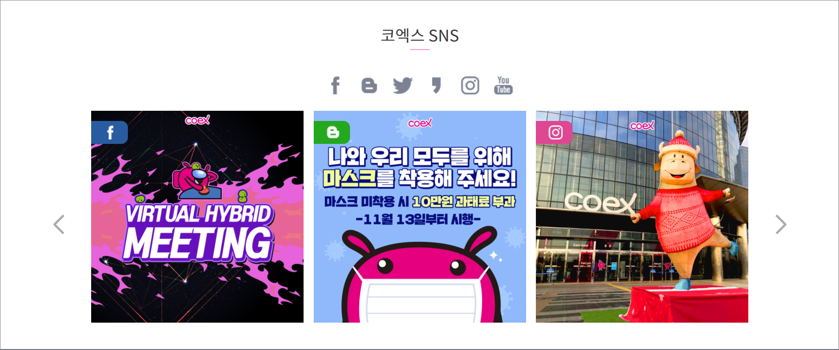
CONTENTS

Slide 12
CONTENTS
- - -
<div.inner>
<section.contents_row3>
<p.title_main>
<ui.sns>
<div.img_list>
<div.img_list >
<div.img_list >

Slide 13
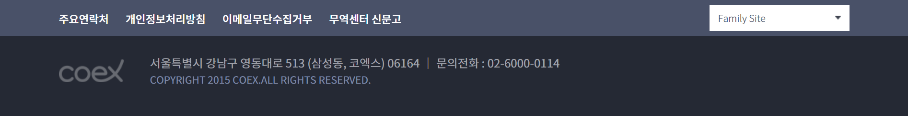
FOOTER
- - -
<div.inner>
<footer>
<ul.fot_menu>
<div.fot_select>
<img
.fot_logo>
<div.fot_copy>

Slide 14
COEX 화면 구현
설계_ 반응형

Slide 15
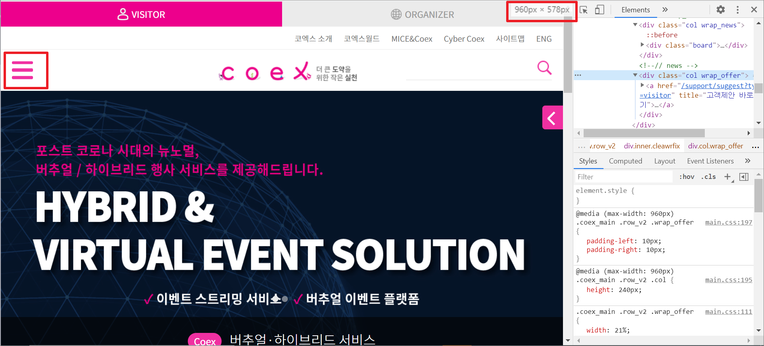
HEADER
960px

Slide 16
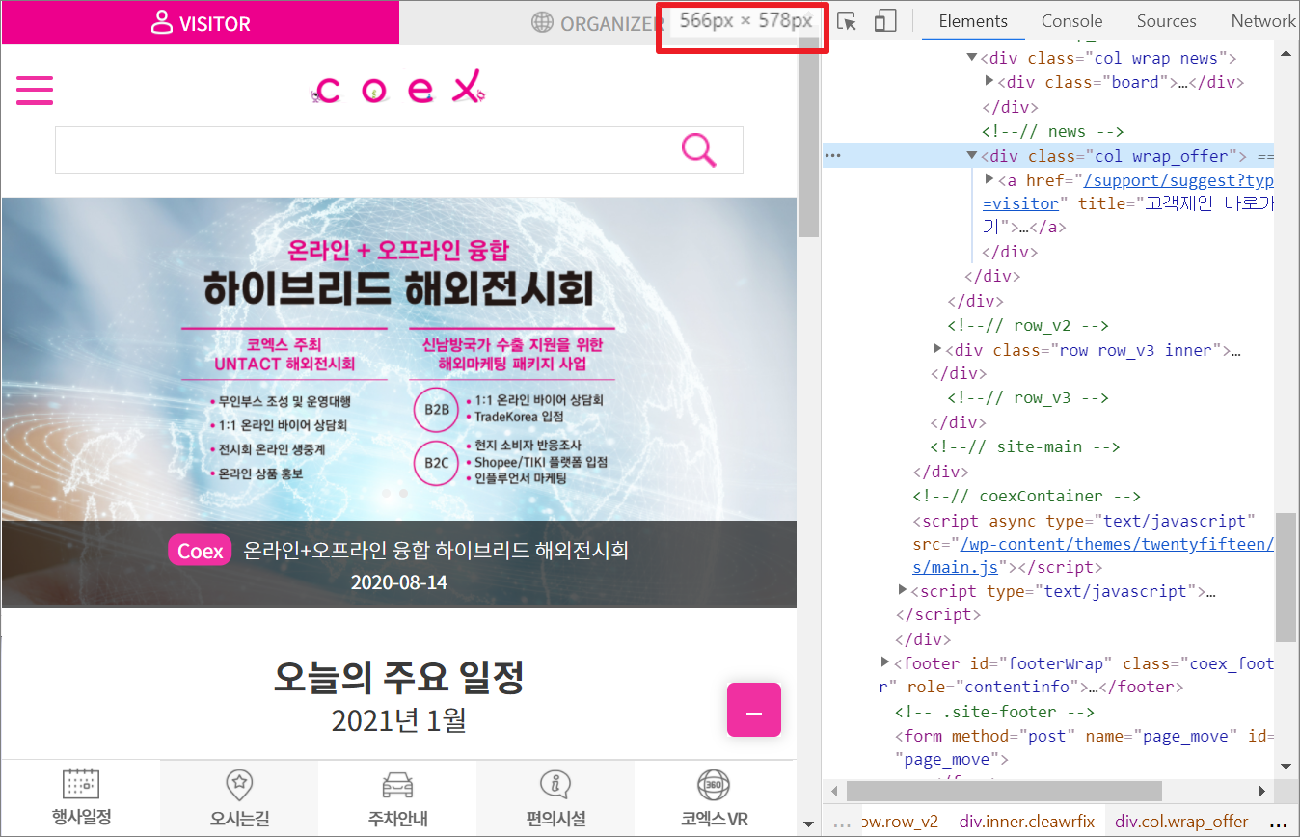
HEADER
566px

Slide 17
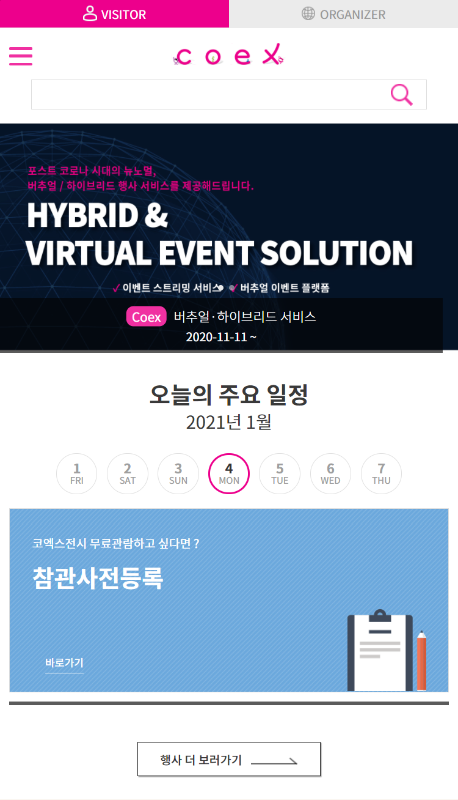
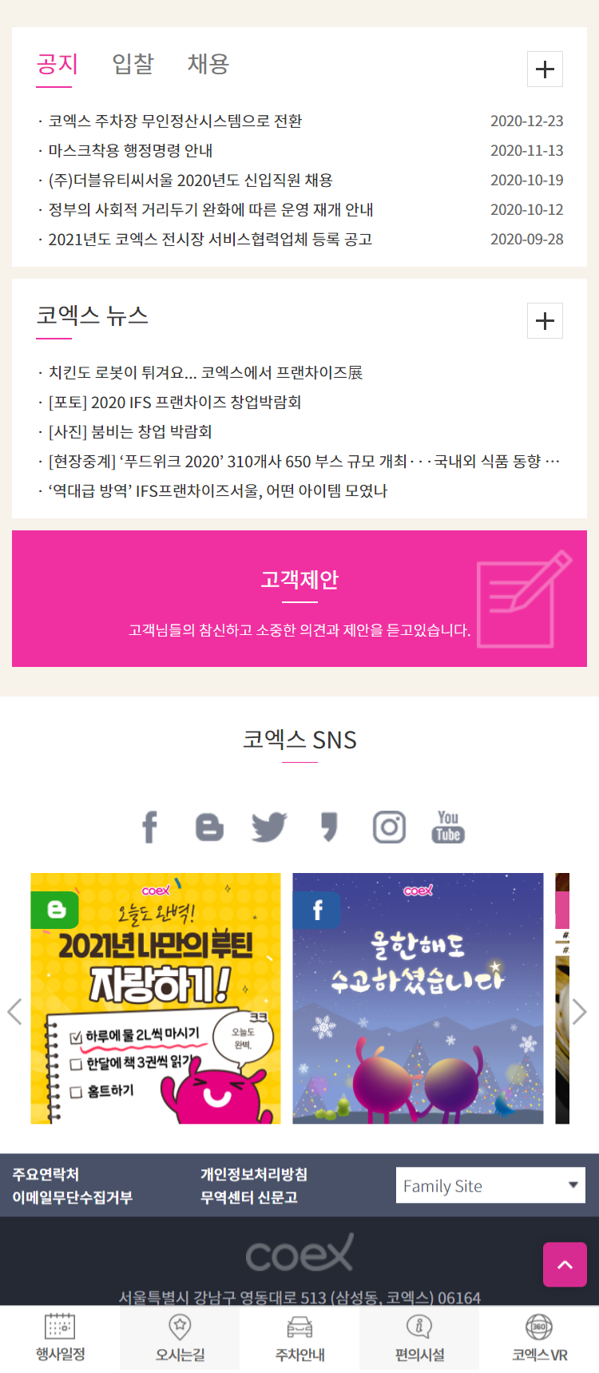

Slide 18
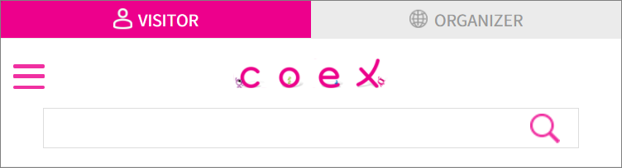
HEADER
<header>
<ul.top_menu>
<ul.top_subMenu>
<img.logo>
<input.search>

Slide 19
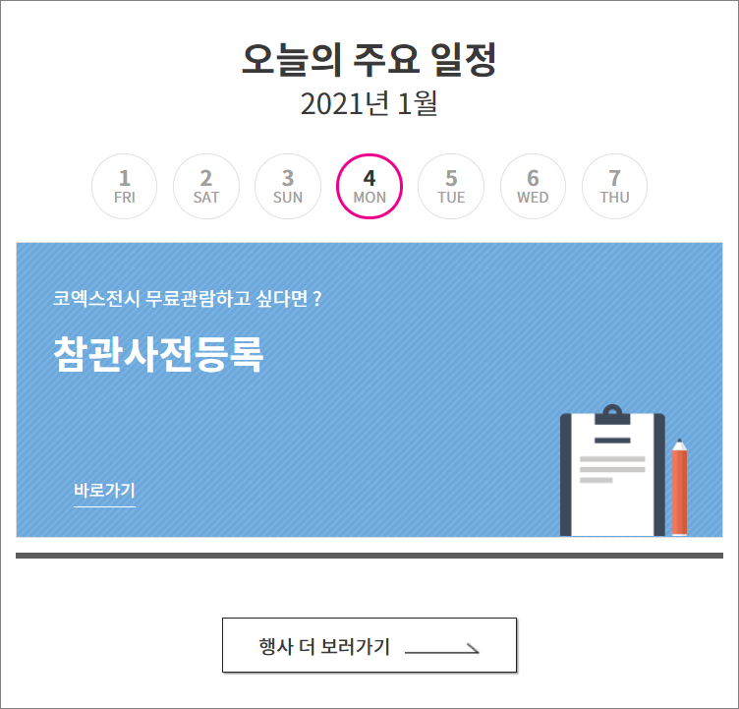
CONTENTS

Slide 20
CONTENTS
<section.contents_row1>
<p. title_main>
<ui.week>
<div.eventBox>
<div. layerBox>
<a.btn>

Slide 21
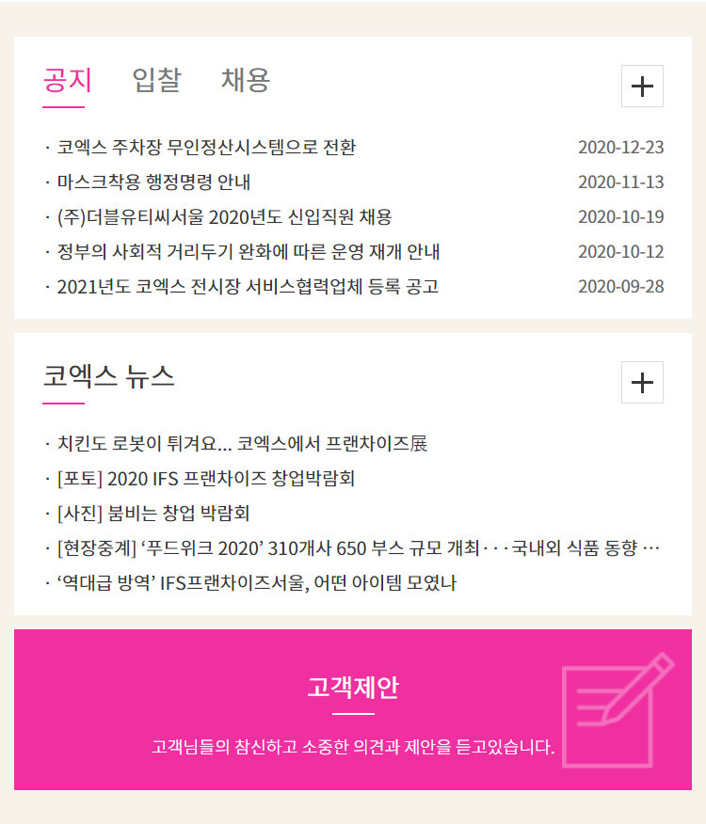
CONTENTS

Slide 22
CONTENTS
<section.contents_row2>
<div.wrap_board>
<div.wrap_news>
<div.wrap_offer>

Slide 23
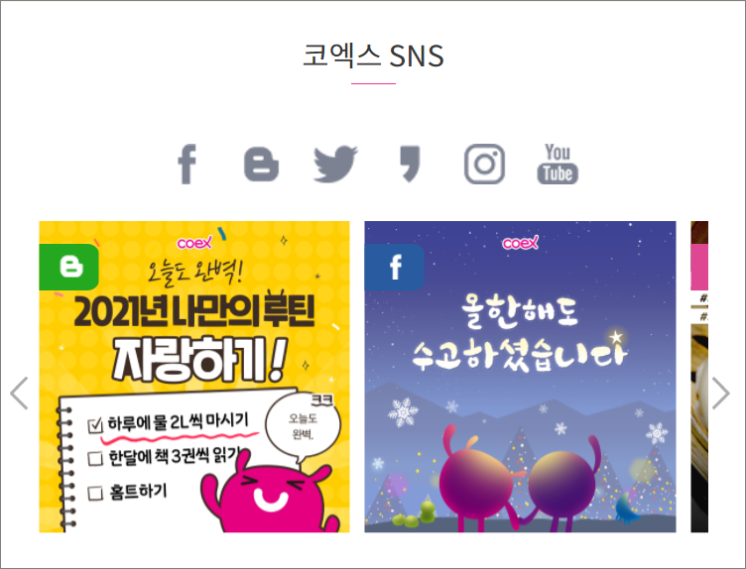
CONTENTS

Slide 24
CONTENTS
<section.contents_row3>
<p.title_main>
<ui.sns>
<div.wrap_board>
<div.wrap_board>

Slide 25
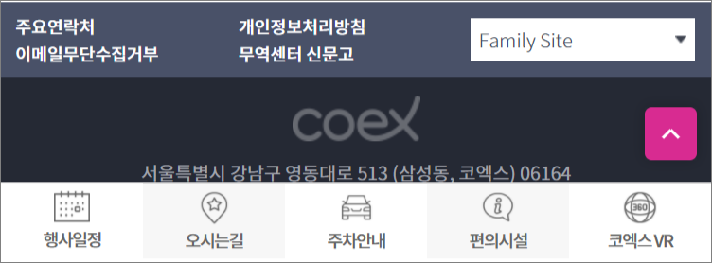
FOOTER

Slide 26
FOOTER
<footer>
<ul.fot_menu>
<div.fot_select>
<img.fot_logo>
<div.fot_copy>
<ul.top_subMenu>

